Slide 1


Bài giảng điện tử
Unit 1: Towns and Cities
Lesson 8: CLIL

Slide 2
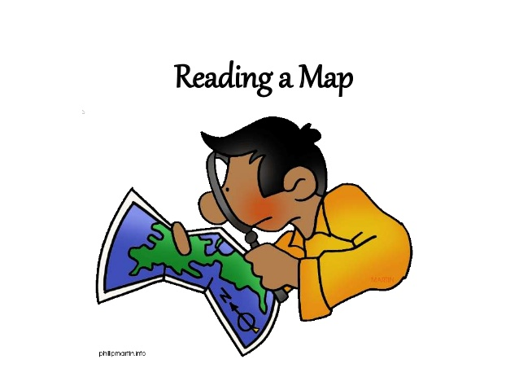
CLIL-GEOGRAPHY: READING A MAP

Slide 3

* Game rules:
-Teacher gives a student a word
and he/she has to draw to explain
that word.
-Teacher invites some students to
answer.

Slide 4
- There are 2 common types
of maps: paper and online.
- We can find places.
WITH
MAPS
- We can find some
information
of a place.
- We can find a way when we lost.
- We can learn.

Slide 5
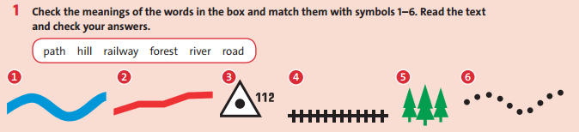
path, hill, railway, forest, river, road

Slide 6
river
road
hill
railway
forest
path

Slide 7
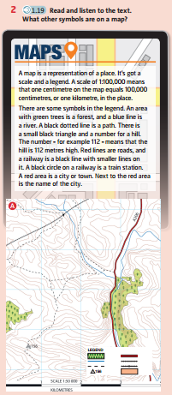


Slide 8
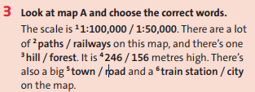

Slide 9
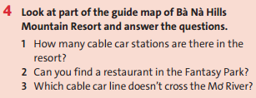
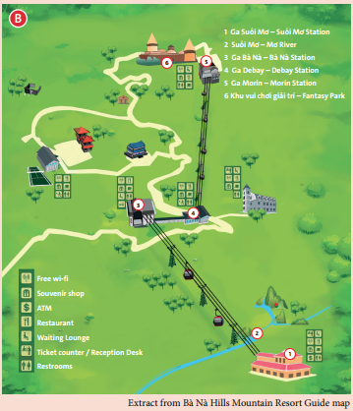
1/ How many cable car stations are there
in the resort?
-> There are 4 cable car stations.
2/ Can you find a restaurant in the
Fantasy Park?
-> Yes, we can.
3/ Which cable car line doesn’t cross the
Mơ river?
-> The cable car from Debay station
to Morin station.

Slide 10

DRAW A MAP IN PAIRS
SHOW THE MAP IN FRONT OF THE CLASS AND DESCRIBE THE FEATURES ON IT.

Slide 11
FOLLOW TEACHER’S INSTRUTIONS.
DRAW A MAP IN GROUPS.

Slide 12

* Homework: - Learn by heart all the new words. - Prepare for the next lesson – Unit 1: Puzzles and games.

Slide 13



www.phuongnam.edu.vn

